Slide 1

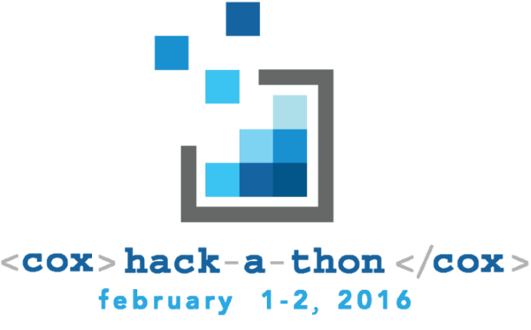
Smart MOPs
CCI Technology Engineering
Keith Rothschild
Dan Geist
Brandon Goode
Kyle Cooper
Gene Granados
Phil Bedard
Mike Eggert
Smart Methods and
Operations Procedures

Slide 2
Problem Statement
Automating things is good, but often limited to setting things up...
Lots of problems
How do we take the Methods and Operational Procedures we create and automate them?

Slide 3
Technology
Today’s demonstration is based on a hacked/mocked framework...
This solution is a novel combination of:
UML-type Model Repository
Policy-Engine
Service Assurance / Telemetry Collection
Automation-Orchestration Framework

Slide 4
General Use Case
Single instance of a server that is part of a load balanced group fails.
Quarantine failed server (if still running)
Create new server instance
Add into service/load balance pool
Result
Service Operational with Designed Protect Group
Isolated (failed) server available for troubleshooting

Slide 5
Demonstration

Slide 6
Other Use Cases
Telemetry
Action
State of Emergency
Inclement Weather
Uneven DOCSIS Channel Use
OSNR/User Demand
Provision Cox Free Wi-Fi
Scale Servers
Re-Groom Customer CPE
Re-Signal and move DWDM Wavelengths

